Slide 1
Adoption Barriers Of Open Standards

Slide 2
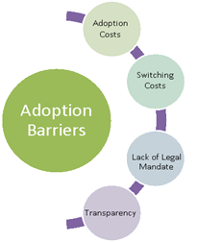
Adoption Barriers

Slide 3
Adoption Costs
Adoption costs of open standards comprises of three attributes namely –
Financial investment – This is the cost that the businesses incur to adopt the new open standard. The investment can be in the form of developing a new infrastructure or changing the existing infra structure to suit the implementation of the standard.
Risks – Considering the transparency that an open standard brings in, there may be some security related concerns that the organization has to deal with.

Slide 4
Adoption Costs
Change Management – History has shown us that people do not like change though it is inevitable. Adopting an open standard initiates the change in process to the existing proprietary standard which may not be welcomed by the people in the organization. There will be additional management overhead involved to initiate the change management process in the organization. This cost is relevant only when the organization is migrating from the existing proprietary standard to a new open standard.

Slide 5
Switching Costs
The switching cost is related to the cost incurred by the organization when migrating from the existing proprietary standard to the open standard.
For example, the switching cost may be the cost incurred in closing the account in one bank and opening the account in another bank or switching the telephone service provider.
Also, the cost involved in learning and implementing the new open standard.

Slide 6
Lack Of Legal Mandate
The government plays an important role in developing a standard or decision making about adopting a standard.
The governments should mandate or impose the adoption of open standard as a policy so that multi vendor competition increases and prevents vendor lock in offering competitive prices.
Even though there are national policies about the need to implement open standards, it is not mandated in most of the cases.

Slide 7
Transparency
The open standard states that the specification should be publicly available and accessible by everyone.
Some of the firms may not want the standard to be transparent concerning the issues related to security.
Such firms would opt for a proprietary standard where the specifications are controlled and owned by the organizations themselves.

